Slide 1
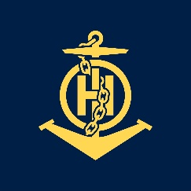
Lessons Learned from CHART project
IHO – NIPPON FOUNDATION
ALUMNI SEMINAR
Hydrographic and Oceanographic Department,
JAPAN COAST GUARD
Rumi BABA

Slide 2
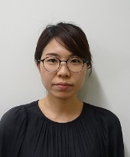
Self introduction
IHO – NIPPON FOUNDATION
ALUMNI SEMINAR
Name | Rumi BABA
Alumni year | 2017
Country | JAPAN
Organization | Hydrographic and Oceanographic Department, Japan Coast Guard
Position/Job title | Chart and Navigational Information Division Assistant Cartography Officer
Current job description | Maintenance of ENCs.
Notes:
I’m Rumi Baba from Japan Hydrographic and Oceanographic Department.
I completed the course in 2017.
I’m working at Chart and Navigational Information Division as an assistant cartographer and I have 4-year experience in ENC production.

Slide 3
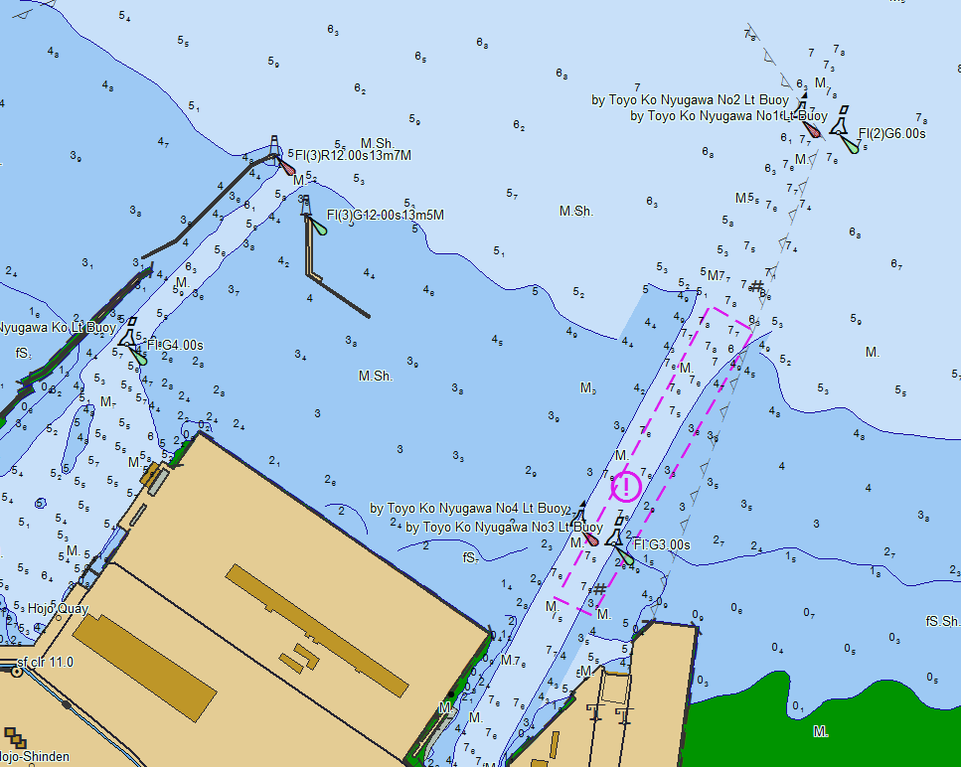
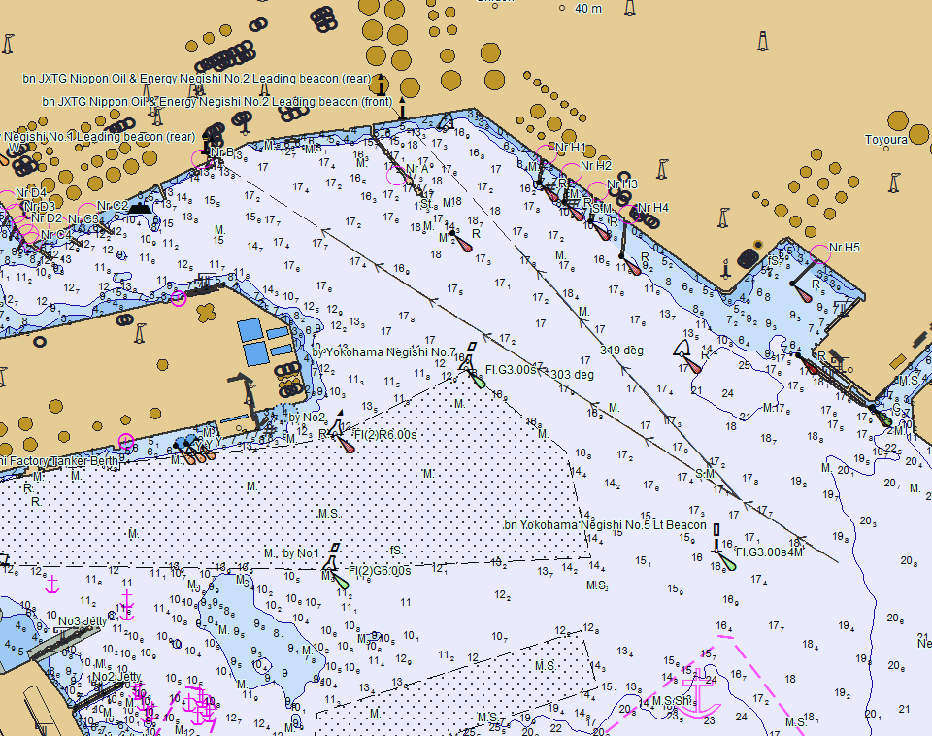
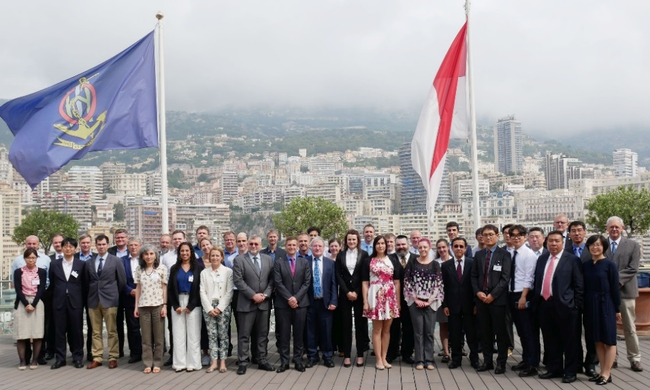
My career path and projects / Achievements
IHO – NIPPON FOUNDATION
ALUMNI SEMINAR
Maintenance of ENCs every week.
Efforts on the new edition of S-58
Attended ENCWG and S-101PT in Monaco this June.
Notes:
１. After the course, I maintain ENCs mainly. Japan publishes more than 800 cells of ENCs and about 800 paper charts and also a lot of Notices to Mariners every week, so I compile ER and do quality checks every week. Therefore it’s hard and busy task to maintain ENCs.
2. New Edition of S-58 was published last year and entered into force last month. My office uses chart production software developed by Japanese company. We had to match the software to new S-58. My role was to read through S-58 and check our ENCs.
3. I attended ENCWG and S-101PT meeting at IHO in Monaco this June. It was the first time to attend an international meeting. Internationally, a lot of topics about S-57 are still discussed for safer navigation. I have brought useful and latest information to my office.

Slide 4
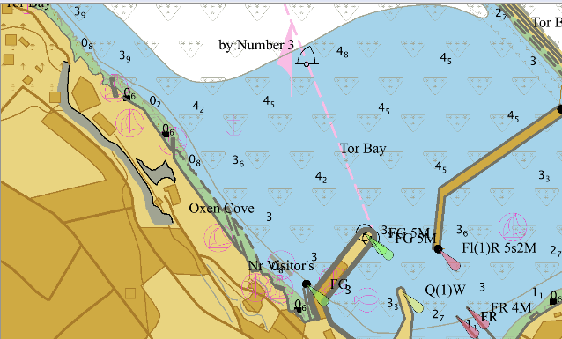
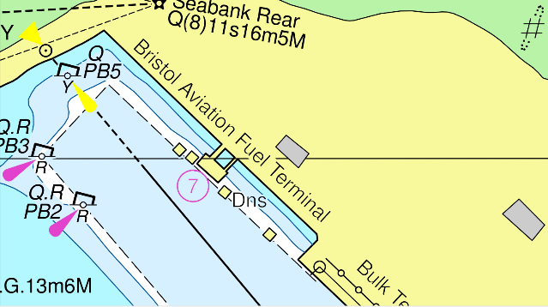
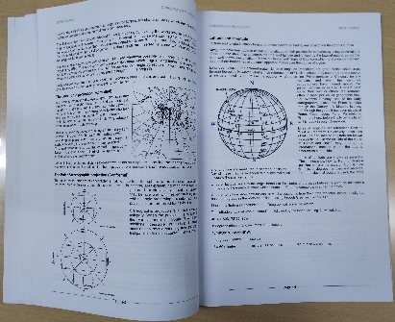
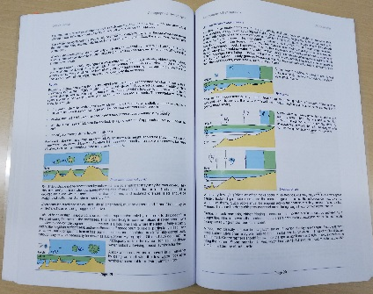
Lessons learned from CHART Course
IHO – NIPPON FOUNDATION
ALUMNI SEMINAR
Sounding selection etc.
Assessment of information received
Educational methods
Notes:
There were four modules in the course. Compilation module was very interesting and informative. Through this training, I was able to learn not only many cartographic skills and knowledge such as sounding selection and buoyage system, but also how to compile charts in UKHO. Basically nautical charts are published based on IHO standards such as S-4 and S-57, but each country has its own compilation policy. I think it was important to find the differences between UKHO and JHOD in order to grow up as a cartographer.
2. And the most useful module for me was Data Assessment module because it is necessary for hydrographic offices to assess correctly how navigationally significant all information received is. I believe what I have learned in this module will help me in the future.
3. In Japan, it is difficult to keep and improve cartographic skills because our staff are transferred to another position every three years. Therefore it was a good opportunity to know how to train students in UKHO. And the textbooks of UKHO are easy to understand and have a lot of fundamental theories and exercises, so I will use them to guide and train junior colleagues.

Slide 5
Suggestion for the future
IHO – NIPPON FOUNDATION
ALUMNI SEMINAR
To continue CHART project
To include lectures about S-101, especially Data Classification and Encoding Guide
Notes:
I hope that IHO and Nippon Foundation continue CHART project. It has a significant meaning in terms of connection with a lot of hydrographic offices around the world.
I recommend to include lectures about S-101, especially Data Classification and Encoding Guide in the near future because many hydrographic offices will prepare to produce S-101 ENCs.

Slide 6
I’m here.
Thank you for listening!

